Slide 1
Data Analysis
2020/12/1
Speaker：Jun-Tsung Wu
Advisor：Prof. Tong-Yu Hsieh

Slide 2
Data Analysis in Python
Advantages
  Workflow flexibility
    Only modify code
  Abundant tool library
    Matplotlib
    Visualization tools
  Code friendly

Slide 3
Pandas
Pandas makes data easier to read, transform and process.
Pandas is a data analysis lib.
  Series: Processing time series data
  DataFrame: Process structured data
You can quickly perform data pre-processing with pandas.
  Fill NA/NaN values

Slide 4
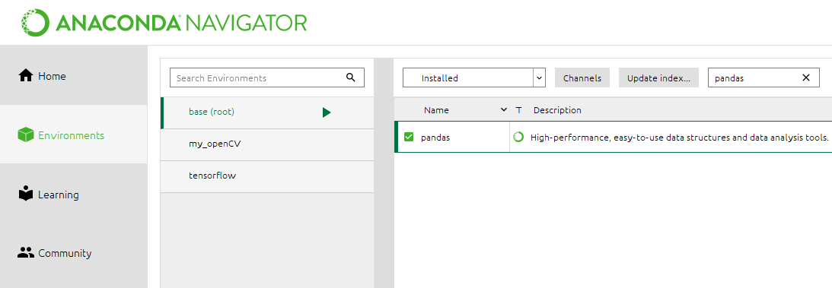
Environment(1/2)
Check pandas lib
  Open anaconda navigator
  Find base(root) in Environment
  Search index: pandas

Slide 5
Environment(2/2)
If you have no pandas lib, open anaconda prompt.
  conda install pandas

Slide 6
Practice

Slide 7
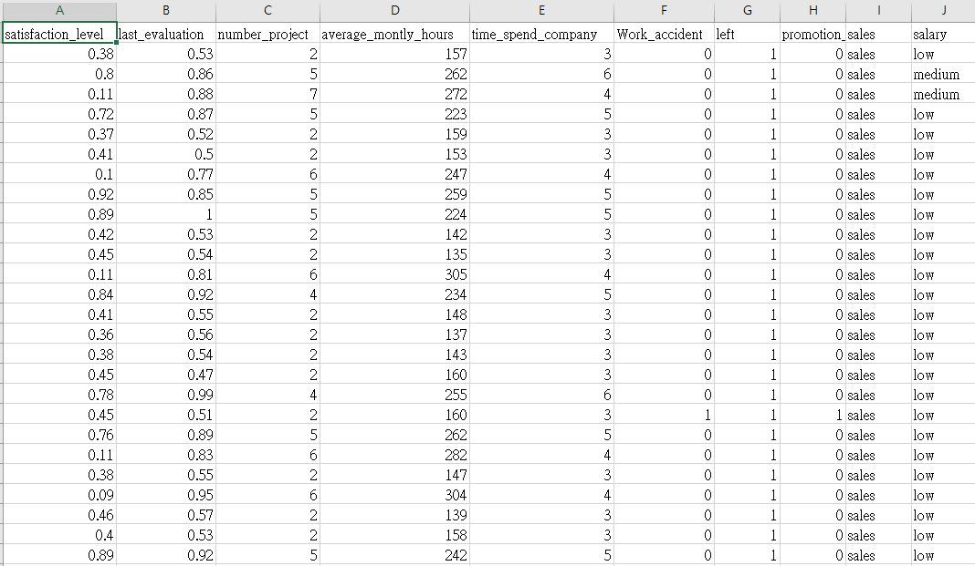
Practice
Predict the dismission rate

Slide 8
Predict Dismission Rate(1/3)
Read file and data integration
  1. read file
  2. determine the data format(number, missing values)
  3. fill in missing values
  4. build and drop column(s)

Slide 9
Predict Dismission Rate(2/3)
Use the Pearson Correlation Coefficient(PCC) to do feature selection
  -1<= PCC <= 1
Split data to 70% train data and 30 % test data

Slide 10
Predict Dismission Rate(3/3)
Predict dismission rate with different regression model
  Partial Least Squares Regression(PLSR)
  Linear Regression
  Ridge Regression
  Lasso Regression
Compare MSE of model
Draw the scatter plot

Slide 11
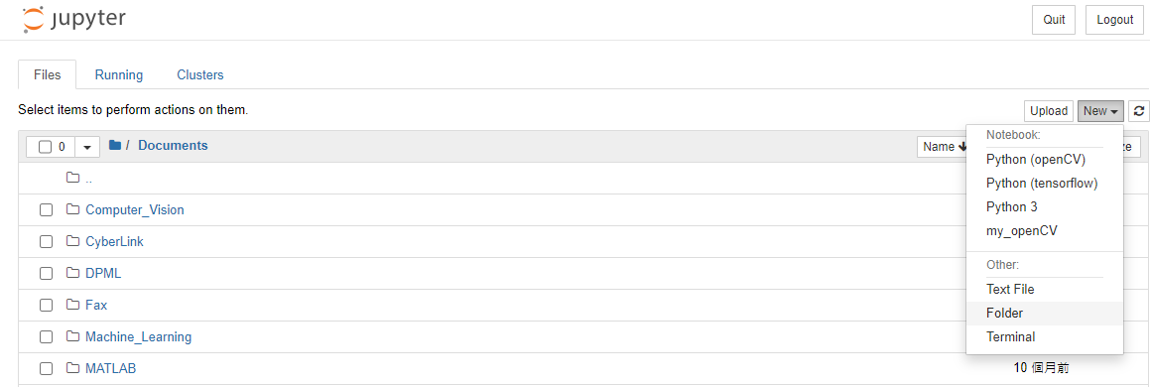
Build Main Folder(1/2)
In Jupyter
  New -> Folder
1
2

Slide 12
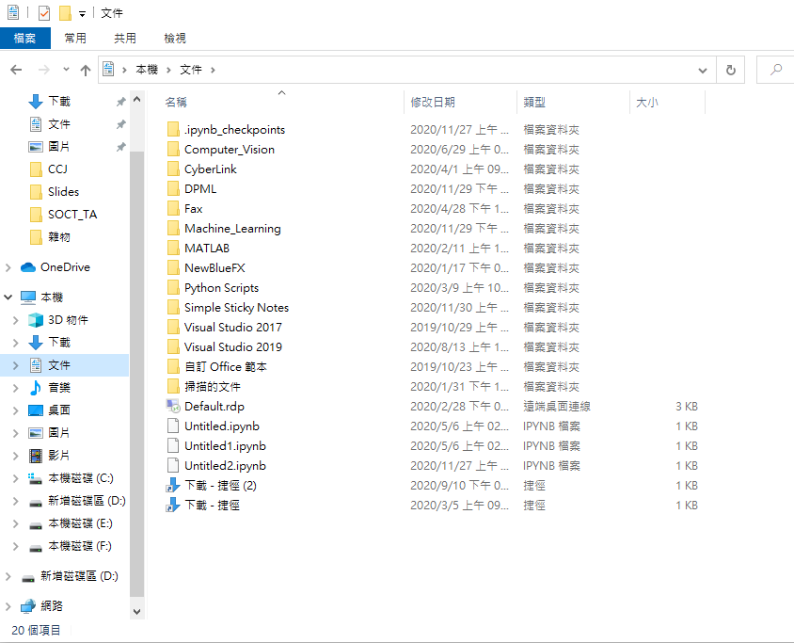
Build Main Folder(2/2)
In user’s computer
  Build folder in document

Slide 13
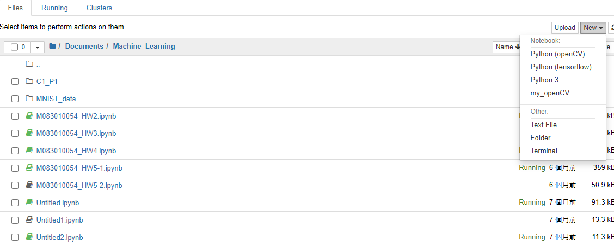
Build New .ipynb File
In your main folder
  New -> python 3(based)
1
2

Slide 14
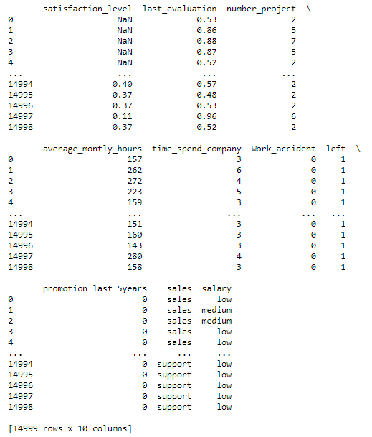
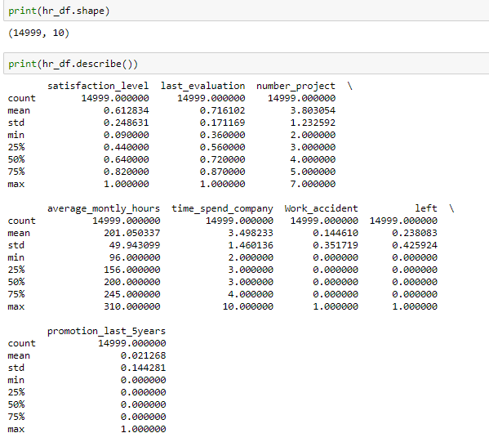
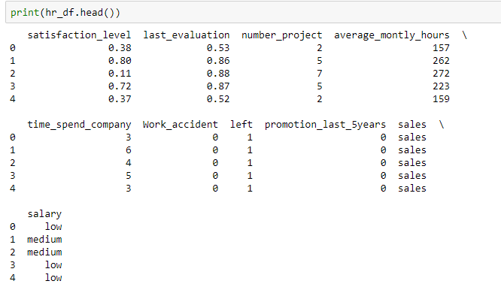
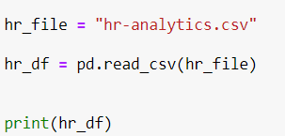
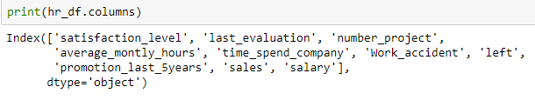
Read File(1/3)
Import pandas as pd
name_df = pd.read_csv(“file path”)
  File path from document
Display name _df
  .shape
  .describe()
  .head()
  .columns

Slide 15
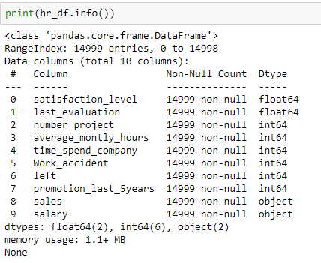
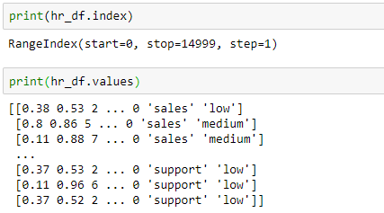
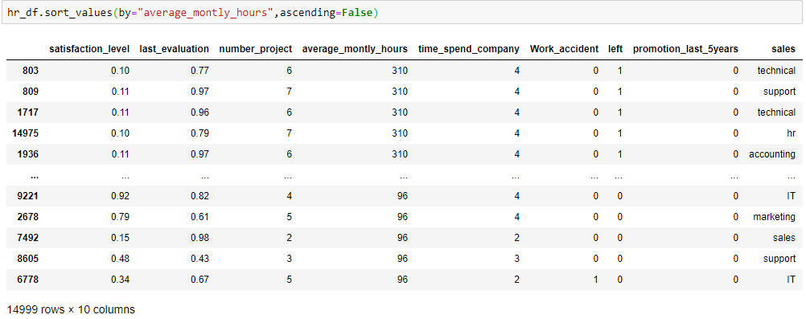
Read File(2/3)
Display name _df
  .index
  .values
  .info()
  .sort_index(ascending=True/False)
  .sort_value(by=[“element_name”], ascending=True/False)

Slide 16
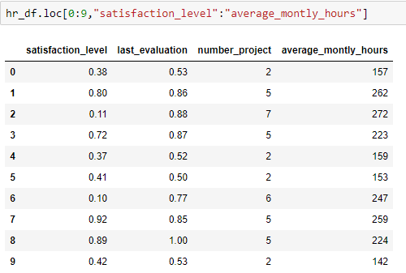
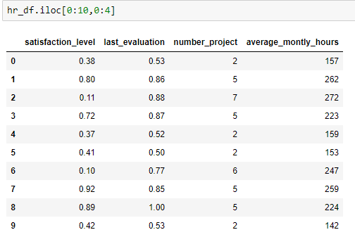
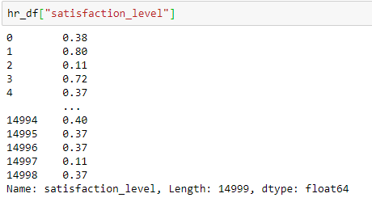
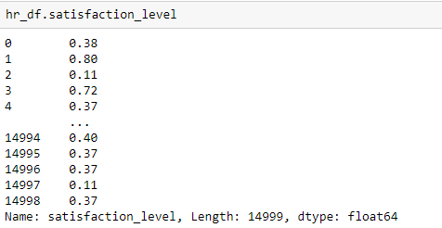
Read File(3/3)
Find row/col in name.df with index/element
  Use name.df[“elementname”] or name.df.elementname
    Find the “satisfaction_level” data
  name.df.loc[“row_label”,”col_label”]
  name.df.iloc[row_index,col_index] (index location)
    Use .loc and .iloc to find top ten data from “satisfaction_level” to “average_monthly_hours”

Slide 17
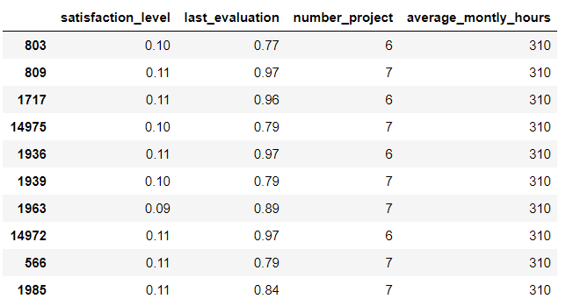
Try it
Find the top ten of average_montly_hours data from “satisfaction_level” to “average_montly_hours”
  Use sort_values and iloc()

Slide 18
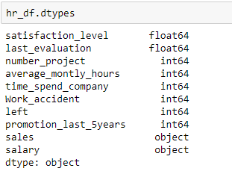
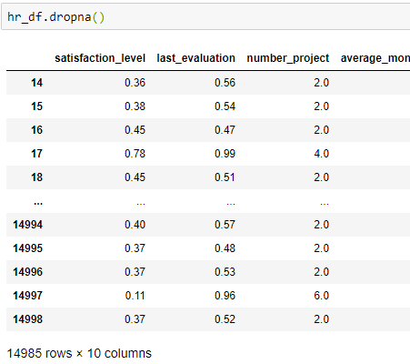
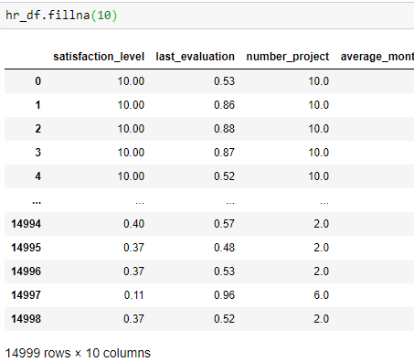
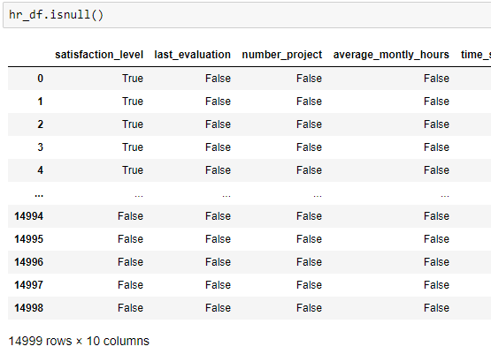
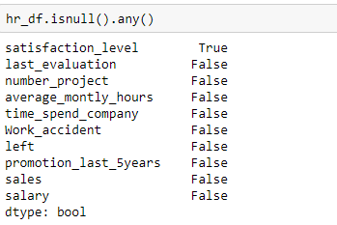
Data Format
Check data format
  .dtypes
  .info()
Check missing data
  .isnull() //or try to .isnull().any()
  .notnull()
  .dropna() // delet the columns which have missing data.
  .fillna(number) // replace the missing data

Slide 19
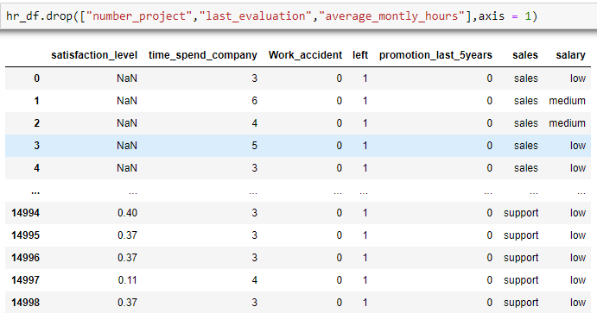
Build and Drop Column(s)
Build column(s)
  Name_df[“new_column”] = x
Drop column(s)
  Name_df.drop([“col_name”],axis=1)
  Name_df.drop(columns=[“col_name”])
Drop row (s)
  Name_df.drop([index])
  Name_df.drop(index=[index])

Slide 20
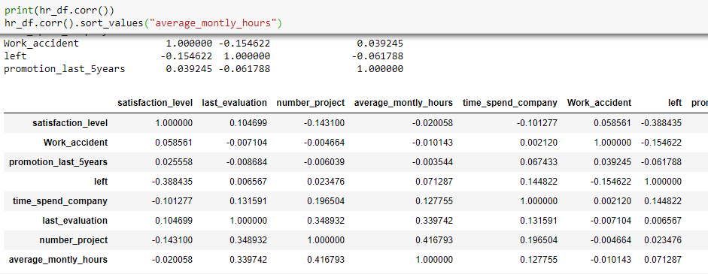
Pearson Correlation Coefficient
In python code
  name_df.corr()
Type of name_df.corr() is the same as name_df, so you can use all the name_df function.

Slide 21
Prepare Train&Test Dataset
Split data to 70% train data and 30 % test data
X : feature data set
y : target data set
test_size : target ratio

Slide 22
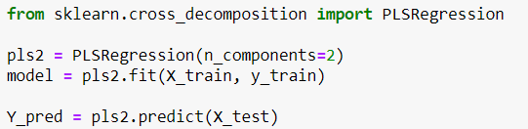
Regression Model
Take PLS regression as an example
X
y
satisfaction_level | last_evaluation | number_project | average_montly_hours | time_spend_company | Work_accident | left
0.38 | 0.53 | 2 | 157 | 3 | 0 | 1
0.8 | 0.86 | 5 | 262 | 6 | 0 | 1
0.11 | 0.88 | 7 | 272 | 4 | 0 | 1
0.72 | 0.87 | 5 | 223 | 5 | 0 | 1

Slide 23

Mean Square Error(MSE)
The smaller the MSE, the more accurate the forecast month.

Slide 24
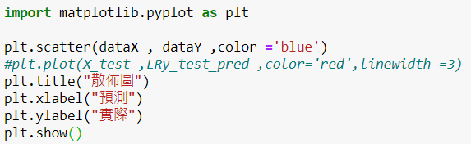
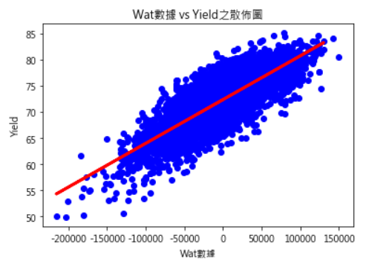
Visualized data
Draw the Scatter Plot

Slide 25
HOMEWork

Slide 26
Homework1
Use pandas to analysis data and discuss the correlation between WAT and Yield.
  Merge the “yield data” and “WAT data”
    Yield.csv & WAT.csv
  Calculate the pearson correlation coefficient value of each WAT to Yield, and sort them
  According to their correlation, and draw the first 10 scatter plots with high correlation

Slide 27
Homework2
Use pandas to predict dismission rate and know how feature data affects the target data
  Use other regression model to predict dismission rate
    hr-analytics.csv
  And discuss which features affects accuracy
    You can do feature transform to increase the accuracy.
  Discuss which model is better?

Slide 28
appendix

Slide 29
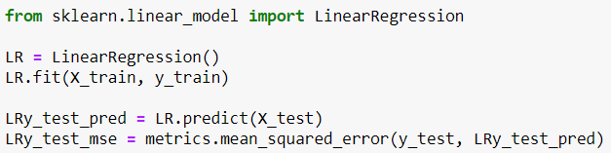
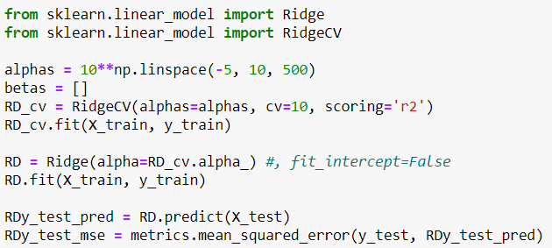
Other Model(1/2)
Linear Regression
Ridge Regression

Slide 30
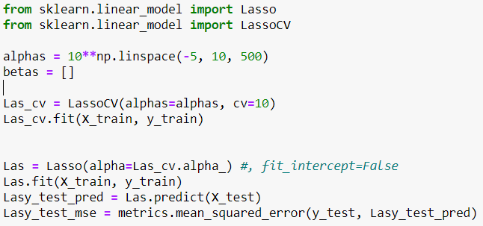
Other Model(2/2)
Lasso Regression

